Slide 1
Module 4 Data Analytics On Text
Major Text Mining Areas – Information Retrieval, Data Mining, Natural Language Processing NLP - Text Analytics Tasks: Cleaning And Parsing, Searching, Retrieval, Text Mining, Part-of-speech Tagging, Stemming, Text Analytics Pipeline – NLP: Major Components Of NLP, Stages Of NLP And NLP Applications

Slide 2
Text Mining
Text data is ubiquitous and growing rapidly.
Text data is also very important because it contains knowledge about users, especially preferences and opinions; text mining is a rapidly changing and constantly developing field of study and research.
The volume of social media, blogs, websites, articles, and other text data is growing rapidly.
There is a need for optimal analysis, extracting knowledge and insight, and categorization of meaningful text content.
Following is the text mining process.
Text Transformation
Data Preprocessing
Feature selection.
Data mining
Evaluation

Slide 3
Text Mining
Text Transformation
Text Transformation is a method used to monitor and control the capitalization of the text. The two main ways of document representation are bag of words and vector space.
Data Preprocessing is used in the field of text mining to derive valuable information and knowledge from unstructured text data.
Feature selection is a significant part of data mining. Feature selection can be defined as the process of reducing the input of processing or finding essential information sources. The feature selection is also called variable selection.
Data mining Furthermore, the data mining process combines with the conventional process.
Evaluation Finally, the result is evaluated.
Data
Pre-processing
Feature Selection
Data Mining
Evaluation
Text mining process

Slide 4
Difference between data mining and text mining
Data Mining | Text Mining
Data Mining is a statistical technique for processing raw data in a structured form. | Text mining is a part of data mining that deals with words, phrases and sentences.
It has similar systems across the world. | It has a variety of systems and it has many dialects and languages.
Data is precise and accurate. | Data can be ambiguous, and the sentiment may be unrelated to the words.
Issues: Issues with missing values, outliers etc. | Issues: Spelling errors. Differing values of proper nouns such as names. Varying quality of language translation.
Pre-existing databases and spreadsheets are used to collect information. | The text is used to collect high-quality information.

Slide 5
Major Text Mining Areas
Information Retrieval
Data Mining
Natural Language Processing (NLP)

Slide 6
Major Text Mining Areas
Information Retrieval
Information retrieval is an automatic process that extracts organized data, important words, attributes, and relationships between entities from loosely organized data and unstructured data.
Typically, it helps in converting the unstructured text into a structured form and obtains important information.

Slide 7
Major Text Mining Areas
Data Mining
Data mining refers to finding out the hidden patterns from the extracted data.
Data mining tools can forecast future patterns and behaviors by finding unknown patterns.
It is useful to address business questions and deal with traditionally time-consuming problems.

Slide 8
Major Text Mining Areas
Natural Language Processing (NLP)
NLP is a subfield of artificial intelligence. It deals with the study of human language.
The entire aim of the NLP is to read, decode, comprehend, understand, and make sense of the human languages in a useful manner.
The development of NLP applications is difficult because of the complexity in the interaction between humans and computers

Slide 9
Case Study: Text Mining Twitter Data
In this, we are going to look at how various terms are related, i.e., how well words are connected and what kinds of words are important. We will gain the idea of what topics people are discussing and what is the trending topic, and we can also analyze different sentiments.
Following are the R packages:
Package tm: A framework for text mining applications.
Package igraph: Network analysis packages of R.
Step 1: Text Cleaning
We will call the two packages tm and igraph and load the Twitter data and the rest of the steps will perform text cleaning.

Slide 10
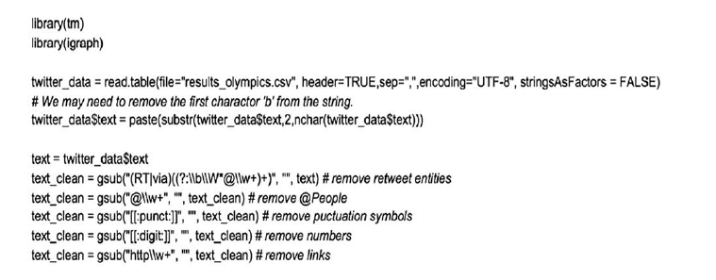
Case Study: Text Mining Twitter Data

Slide 11
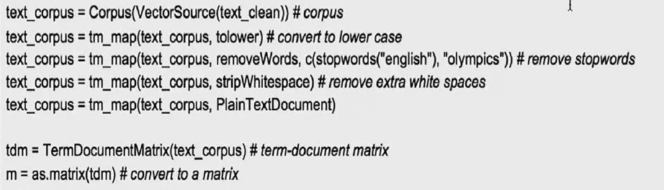
Case Study: Text Mining Twitter Data
Step 2: Creation of Corpus and Term-Document Matrix
Further, we create a corpus, which is a set of words in the dataset. And, then, we need to create a term-document matrix. This is to indicate which term or word is appearing in which document and how often.

Slide 12
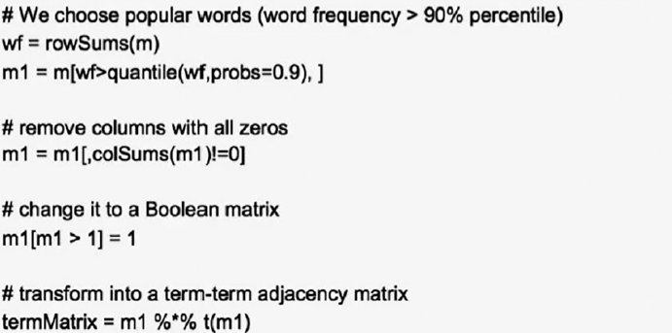
Case Study: Text Mining Twitter Data
Step 3: Popular Words
There are n number of words, and some of the words are not useful. Stop words are the most commonly used words such as a, an, the, is are, and she. Stop words are first filtered.

Slide 13
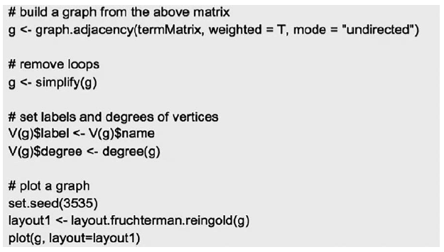
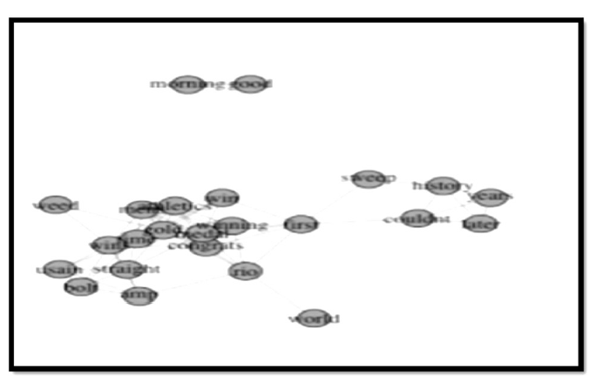
Case Study: Text Mining Twitter Data
Step 4: Build and Plot Graph

Slide 14
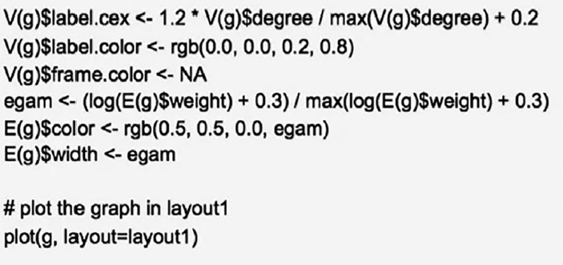
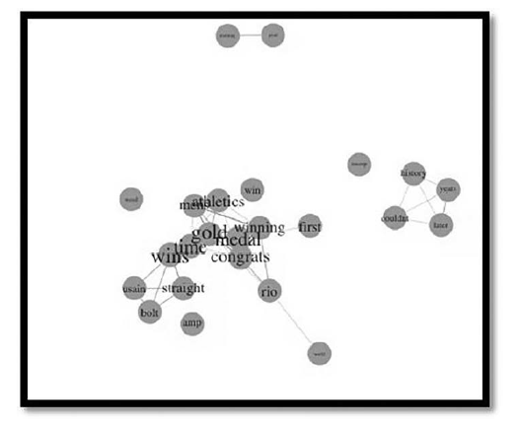
Case Study: Text Mining Twitter Data
The better graph: The revised graph makes important terms stand out.

Slide 15
Case Study: Text Mining Twitter Data
Conclusion
What we have done here is a social network study, but what we have just seen here are words in a tweet.
This method can be extended to all sorts of social network analysis. You could have users, nodes on Twitter, Facebook, and other things. We can use any term in term-document matrix.
Using this method and working on many steps further we can do any type of analysis by using any data.

Slide 16
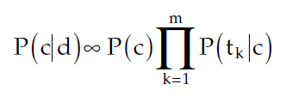
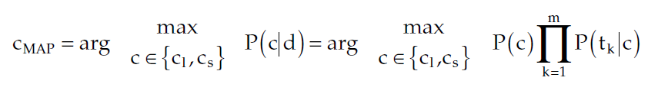
Spam Email Classification
The NB classifier is a probabilistic learning algorithm that derives from Bayesian decision theory. The probability of a message d being in class c, P(c|d), is calculated as follows.
P(tk|c) – the conditional probability of feature tk occurring in a message of class c, which can be used to measure how much evidence tk contributes that c is the correct class.
P(c) – prior probability of a message occurring in class c.
In email classification, the class of a message is determined by finding maximum a posteriori class (cMAP) defined by the following:

Slide 17
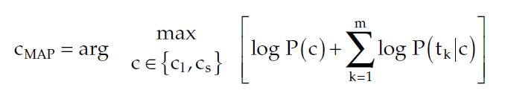
Spam Email Classification
The multiplication of probabilities is often converted to the addition of logarithms of probabilities, and, therefore, the maximization of the equation is alternatively performed by the following:
All model parameters, i.e., class priors and feature probability distributions, can be estimated with relative frequencies from the training set.
When a given class and message feature do not occur together in the training set, the corresponding frequency-based probability estimate will be zero, which would make the right-hand side of the above equation undefined. This problem can be mitigated by incorporating some corrections such as Laplace smoothing in all probability estimates.
Apart from this, many other algorithms such as LogitBoost (LB), support vector machine (SVM), augmented latent semantic indexing space model (LSI), and radial basis function (RBF) networks are used.

Slide 18
Text Analytics
Text analysis refers to the representation, processing, analyzing, and modeling of a huge amount of text data to provide valuable insights.
Text mining – the method of determining the relationship and interesting patterns in large text collections – is an essential component of text analysis.
Text analysis is the automated process of understanding and sorting unstructured text data with machine learning to mine for valuable insights.
This technique helps us to automatically extract, classify, and identify text data, such as comments, queries, messages, requests, tweets, emails, product reviews, and survey responses.

Slide 19
Text Analytics
Table shown below provides some sample data sources and data formats that text analysis would have to deal with.
Data Source | Data Structure Type | Data Format
Email | Unstructured | TXT, MSG, IMG
Web pages | Semi-structured | HTML, IMG
Server logs | Semi-structured or quasi-structured | LOG or TXT
News articles | Unstructured | TXT, HTML
Literature | Unstructured | TXT, DOC, HTML, or PDF
Social network API firehouses | Semi-structured | XML, JSON, or RSS

Slide 20
Text Analytics Subtasks
Cleaning and Parsing
Searching and Retrieval
Text Mining
Part-of-Speech Tagging
Stemming
Lemmatization

Slide 21
Text Analytics Subtasks
Cleaning and Parsing
Before you can do a text analysis project, you also need to do a lot of text cleaning and parsing. That is because much of the text is formed and stored so that people can understand it, and it is not always easy for a machine to process that text.
Computers work well and are familiar with the data when there is a structure to a data source or, at least, some regular patterns that it can identify.
Most cleaning and parsing for text analysis involves increasing the regularity (e.g., fixing typos) or adding structure (tagging certain words as important, or even splitting documents up into different sections that have special meaning – title, authors, chapters, etc.).
]

Slide 22
Text Analytics Subtasks
Cleaning and Parsing
Typically, parsing is a process that uses unstructured text and creates a structure for further analysis.
Unstructured text can be a simple text file, a blog article, an extensible markup language (XML) file, or a hypertext markup language (HTML) file.
Parsing deconstructs and works out on the text given and makes it in a more organized way for subsequent steps.

Slide 23
Text Analytics Subtasks
Searching and Retrieval
This procedure is originated from library science. It is the identification of documents in a corpus that contains key terms such as words, phrases, topics, and entities.
Text Mining
Text mining is sometimes referred to as text data mining. Text data mining is the process of transforming unstructured text data into a structured format. It identifies meaningful patterns and new insights from the texts. Text mining uses natural language processing to transform the unstructured text to structured which is suitable for machine learning algorithms.

Slide 24
Text Analytics Subtasks
Part-of-Speech Tagging
Part-of-speech (PoS) tagging can be known as the process of assigning the parts of speech to the selected word. Simply put, it can be said that PoS labeling is the function of labeling every word in a sentence with its appropriate part of speech.
Noun | Verb | Preposition | Noun
Jane | went | to | school
Example of PoS

Slide 25
Text Analytics Subtasks
Stemming
Stemming is considered an important process. It strips the words and extracts the base form of that particular word. This step is done by removing the affixes of the word. For example, the stem of the word “sleeping” and “sleep’s” is “sleep”.
List of Various Stemming Algorithms
Porter Stemming Algorithm
Lancaster Stemming Algorithm
Regular Expression Stemming Algorithm
Snowball Stemming Algorithm
Stemming algorithms.

Slide 26
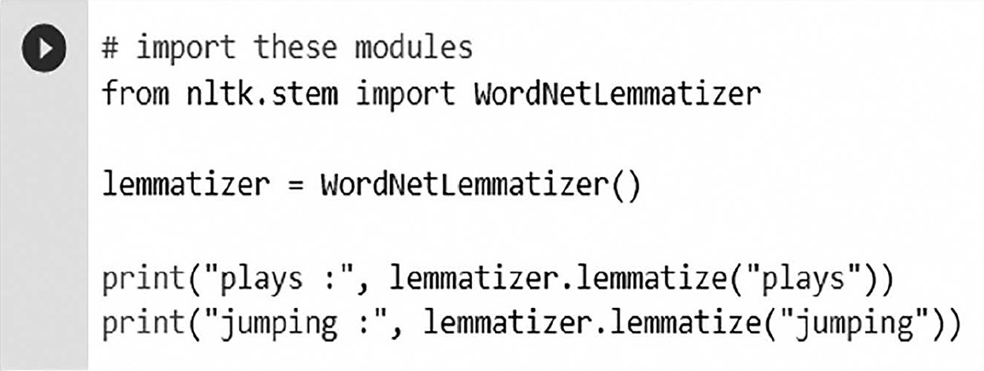
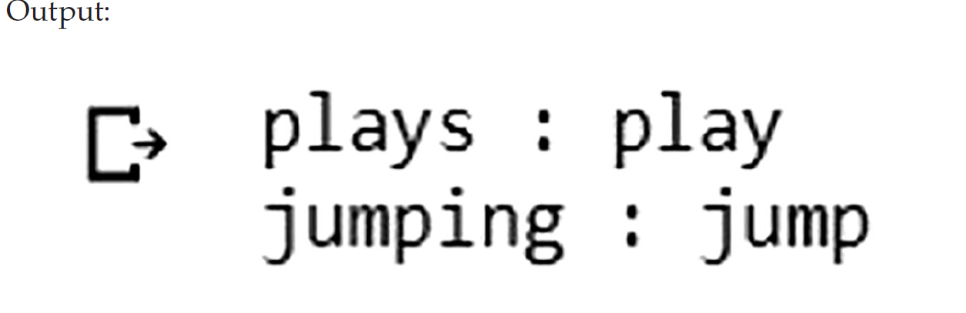
Text Analytics Subtasks
Lemmatization
The lemmatization technique is similar to stemming. It finds the root word of the given word. The output of this technique is called “lemma”. In short, it gives the base form of the given word.
Example of lemmatization

Slide 27
Basic Text Analysis Steps
Collection of Raw Data
Data Representation
Document grouping
Determining Sentiments
Gaining Insights

Slide 28
Basic Text Analysis Steps
Collection of Raw Data Raw data is referred to as primary data. It is the starting point of text analysis. The data may be comments and reviews on websites, news portals, blogs, articles, server logs, etc. This data is continuously monitored by the companies.
Data Representation In this phase, the text data is transformed into a better- organized form using the text normalization techniques. Tokenization is one of the text normalization techniques where the words are separated from the actual body of the text. The text is converted into a collection of tokens, where tokens are words, numbers, and punctuations.
For example, “Sam went to the park”.
After tokenization: {Sam, went, to, the, park}

Slide 29
Basic Text Analysis Steps
Document grouping Document grouping can be achieved by clustering or classification methods. One of the best ways is topic modeling. Topic modeling offers tools to automatically organize, scan, understand, and summarize vast quantities of information. Topic models are statistical models that analyze words from a collection of documents, evaluate themes over the text, and discover how the themes are related or modified over time.
Determining Sentiments Sentiment analysis used various algorithms to determine the opinions, which is required to obtain subjective information from the text. The sentiments can be classified as negative and positive sentiments.
• Gaining Insights This is a visual representation of the opinions. For example, the word cloud removes all the stop words and displays only important words so that data scientists can see the opinions.

Slide 30
Introduction to Natural Language Processing
NLP is a form of artificial intelligence that helps the machine to read, decode, comprehend, and understand the text by simulating the human ability to understand the language.
NLP techniques utilize a range of approaches, including linguistics, semantics, statistics, and machine learning, to extract entities, relationships, and to understand the meaning, allowing an understanding of what is being said or written.
Instead of just understanding single words or a set of words, NLP lets computers understand whole sentences as they are spoken or written by a human.
It uses many methodologies to decipher ambiguities in language, including automatic summarization, PoS tagging, disambiguation, entity extraction, and relation extraction, as well as disambiguation and natural language understanding and recognition.

Slide 31
Major Components of NLP
Components of NLP
Natural Language Understanding
Natural Language Generation

Slide 32
Major Components of NLP
Natural Language Understanding (NLU)
In this phase, the speech input is transformed into useful representations to evaluate different aspects of the language. Although the natural language is so rich in forms and structures, it is also really complex and ambiguous.
There may be numerous forms of ambiguity, which are mentioned below such as lexical ambiguity, which is quite simple, i.e., word-level ambiguity. For example, a “present” could be a noun or a verb.
Then, there can be syntactical ambiguity, which occurs when a sentence is parsed in different ways. For example, in the sentence “The professor saw the boy with the telescope”, it is ambiguous whether the professor saw the boy carrying a telescope or he saw him through his telescope.
Furthermore, there is a referential ambiguity. Let us discuss this with an example, “John went to meet Sam”. He said, “I am tired”. Now, who exactly is tired is not made clear in this sentence.

Slide 33
Major Components of NLP
Natural Language Generation (NLG)
For the generation of the output text, the intermediate representation requires to be converted back to the natural language format. Thus, there are several subprocesses involved in this process. They are as follows:
The text planning phase includes extracting relevant and important content from the knowledge base.
Sentence planning involves selecting correct words, forming meaningful sentence with language grammar, and setting the tone for the same.
Text realization is a process of mapping the planned sentence into a structure.

Slide 34
Stages of NLP
Syntactic Analysis
Semantic Analysis
Discourse Integration
Pragmatic Analysis
Lexical Analysis
Stages of NLP

Slide 35
Stages of NLP
1. Lexical Analysis
Lexicon is the words and phrases in the language. The lexicon analysis phase deals with the recognition and identification of the structure and formation of the sentences. It divides the paragraphs into sentences, phrases, and words.
2. Syntactic Analysis
In this phase, the grammar of the sentence is examined to get the relationships among different words in the sentence. The sentence is parsed as nouns, verbs, adjectives, and another part of a sentence.

Slide 36
Stages of NLP
3. Semantic Analysis
In the semantic analysis, the actual true meaning of the sentence is extracted from the structure and the words used. It checks whether the sentence is meaningful. It maps the object with its syntactic structure to decide the correctness and accuracy of the sentence. For example, “cold fire” will be termed a wrong sentence.
4. Discourse Integration
The meaning of discourse for NLP is nothing but the context of the sentence or a word. Generally, the meaning of a sentence majorly depends on or changes according to the context, i.e., the sentence before and after that given sentence. In disclosure integration, the meaning of a sentence gets verified with the sentence before it.

Slide 37
Stages of NLP
5. Pragmatic Analysis
This phase deals with the meaning of the sentence in various situations. In the pragmatic analysis, the sentences are reinterpreted to verify the correctness of the meaning in the given context. Real-world knowledge is required.

Slide 38
Statistical processing of Natural Language
Statistical processing of natural language represents the classical model of information retrieval systems and is characterized by each document’s set of keywords, known as the term index. It is based on a bag of words.
Here, all the terms in a document are considered as its index terms.
Every term is assigned a weight in the function of its importance, mostly determined by its appearance frequency within the document. This way, the word’s order, structure, meaning, etc., are not considered.
These models are then limited to pairing the document’s words with that of the query’s. Its simplicity and efficacy have become the most commonly used contemporary models in textual information retrieval systems.

Slide 39
Statistical processing of Natural Language
The statistical processing model involves two stages, which are as follows.
Document Preprocessing
This consists of preparing the document for its parameterization, eliminating any elements considered as superfluous.
Parameterization
A stage of minimal complexity once the relevant terms have been identified. This consists of quantifying the characteristics of the documents, i.e., the terms.

Slide 40
Applications of NLP
Virtual Assistants
The virtual assistants are used for automatic question answering. It is designed to comprehend and understand natural language and deliver the relevant response through natural language generation.
Sentiment Analysis
Mostly used on website and social media tracking, NLP is an excellent method for interpreting and analyzing the replies to business messages published on social media platforms. It helps to evaluate the attitude and emotional state of a person who comments on posts. This is implemented through a combination of NLP and statistics by assigning text values as positive, negative, or neutral. This will help in making necessary adjustments in business according to customer’s opinions.

Slide 41
Applications of NLP
Automatic Summarization
In automatic summarization, the huge text is simplified into readable form. It summarizes text, by retrieving important and relevant information.
Machine translation
Machine translation is the most complex and difficult application of NLP. Machine translation is automatically translating text from one language to another. It requires a deep knowledge that humans have, for example, grammar, semantics, and facts about the real world. It is required to carry out all the translations in a proper manner.
Speech Recognition
In speech segmentation, from the given sound clip of a person or people speaking, words are separated. It is a sub-task of speech recognition and is typically grouped with it.

